Slide 1

Random Effects, and what to do when there is no existing method. Biology 683 Heath Blackmon

Slide 2
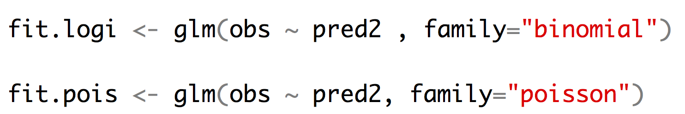
Other kinds of regression
Logistic regression allows us to fit a binary response variable (absent/present; alive/dead) with one or more categorical or continuous predictor variables.
Poisson regression allows us to fit a response variable that is Poisson distributed (number of extinctions in a unit of time, number of colonies per plate, (number of occurrences for rare events)) with one or more categorical or continuous predictor variables.

Slide 3
GLM and LM function in R
The GLM and LM function in R takes equations that can be described with the following operators
+ +X include this variable
: X:Z include the interaction between these variables
∗ X∗Y include these variables and the interactions between them
^ (X + Z + W)^3 include these variables and all interactions up to three way

Slide 4
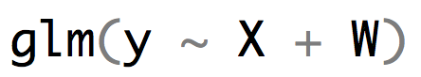
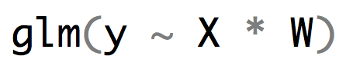
R versus the math implied
$y_{i}=β_{0}+β_{1}X_{i}+β_{2}W_{i}+ε_{i}$
$y_{i}=β_{0}+β_{1}X_{i}+β_{2}W_{i}+β_{3}{X_{i}W}_{i}+ε_{i}$

Slide 5
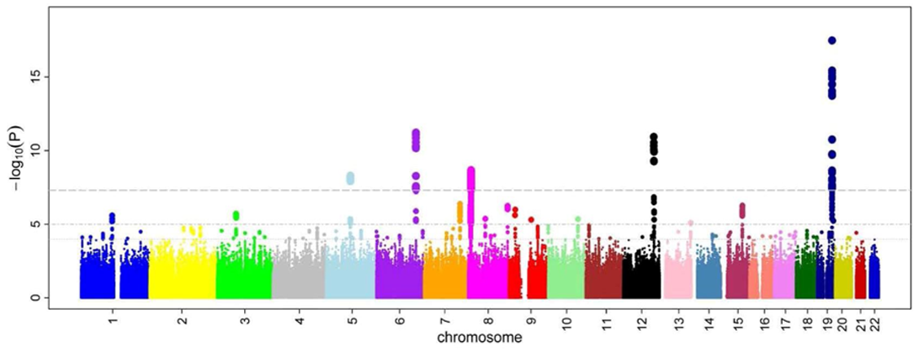
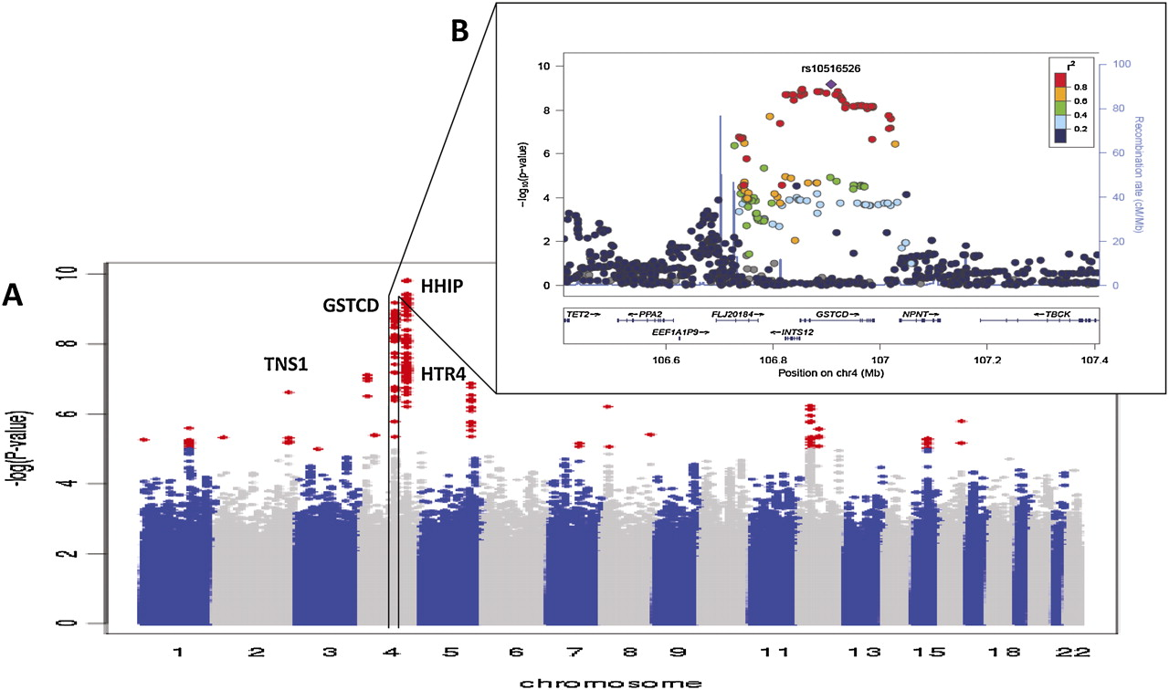
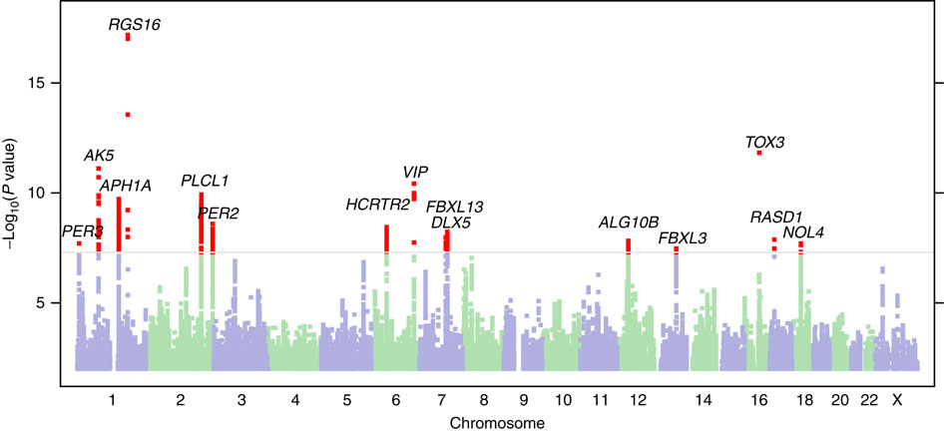
GWAS

Slide 6
GWAS
GWAS: Genome wide association study.
The goal of GWAS is to determine what genes have alleles that are responsible for a trait of interest. The trait can be any measurable trait in any organism that you wish to study. For instance, a disease in humans, an economically important trait of a crop or domestic animal, an adaptation like a certain color pattern in birds, etc.

Slide 7
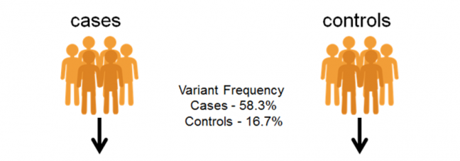
GWAS – Discrete condition (often disease)
>case 1
CATACTACTACTGAACGTTTGCTCCTGCtactatctctctctctctctctttctctctctctctctCATGC >case 2
AGTTGACTACTGCATACTCGTGCTAGCTGACTGTCGTACGTACGTAGCTAGTGATCGATCGATGCTAGCTA>case 3
CATACTACTACTGAACGTTTGCTCCTGCtactatctctctctctctctctttctctctctctctctCATGC >control 1
AGTTGACTACTGCATACTCGTGCTAGCTGACTGTCGTACGTACGTAGCTAGTGATCGATCGATGCTAGCTA>control 2
CATACTACTACTGAACGTTTGCTCCTGCtactatctctctctctctctctttctctctctctctctCATGC >control 3
AGTTGACTACTGCATACTCGTGCTAGCTGACTGTCGTACGTACGTAGCTAGTGATCGATCGATGCTAGCTA

Slide 8
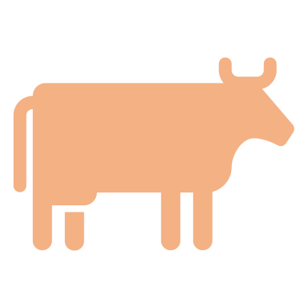



GWAS – Continuous trait
>sample 1
CATACTACTACTGAACGTTTGCTCCTGCtactatctctctctctctctctttctctctctctctctCATGC >sample 2
AGTTGACTACTGCATACTCGTGCTAGCTGACTGTCGTACGTACGTAGCTAGTGATCGATCGATGCTAGCTA>sample 3
CATACTACTACTGAACGTTTGCTCCTGCtactatctctctctctctctctttctctctctctctctCATGC >sample 4
AGTTGACTACTGCATACTCGTGCTAGCTGACTGTCGTACGTACGTAGCTAGTGATCGATCGATGCTAGCTA>sample 5
CATACTACTACTGAACGTTTGCTCCTGCtactatctctctctctctctctttctctctctctctctCATGC >sample 6
AGTTGACTACTGCATACTCGTGCTAGCTGACTGTCGTACGTACGTAGCTAGTGATCGATCGATGCTAGCTA

Slide 9
GWAS – Continuous trait
AGTTGACTACTGCATACTCGT
AGTTGACTACTGCATACTCGT
AGTTGACTACTGCATACTCGT
AGTTGACTACTGCATACTCGT
TGTTGACTACTGCATACTCGT
AGTTGACTACTGCATACTCGT
TGTTGACTACTGCATACTCGT
TGTTGACTACTGCATACTCGT
AGTTGACTACTGCATACTCGT
TGTTGACTACTGCATACTCGT
TGTTGACTACTGCATACTCGT
TGTTGACTACTGCATACTCGT
coat color
Not significant
AA AT TT

Slide 10
GWAS – Continuous trait
AGTTGACTACTGCATACTCGT
AGTTGACTACTGCATACTCGT
AGTTGACTACTGCATACTCGT
AGTAGACTACTGCATACTCGT
TGTAGACTACTGCATACTCGT
AGTAGACTACTGCATACTCGT
TGTAGACTACTGCATACTCGT
TGTTGACTACTGCATACTCGT
AGTAGACTACTGCATACTCGT
TGTAGACTACTGCATACTCGT
TGTTGACTACTGCATACTCGT
TGTTGACTACTGCATACTCGT
coat color
Highly significant!
AA AT TT

Slide 11
GWAS - Problems
What is the problem with doing this across the whole genome?
Multiple tests lead to more false positives!
require a higher level of significance 5x10⁻⁸
only look at the very most significant
lots of more complicated approaches too!
What is one of the most basic requirements of almost all statistical tests?
Tests normally assume independence of the data points!
Samples from a population will be related to each other due to ancestry (trees!)
DNA sequencing is not done equally in all groups of people (western samples are usually over represented

Slide 12
GWAS - Problems
What is epistasis?
It is the case where the impact of a genotype at one locus depend on the genotype at another locus!
To find this type of effect you would need to look at all pairs of genotypes. How many tests would we need to do then?
About 6 orders of magnitude more tests would be required.
Humans have around 4,000,000 sites that are variable like this which equates to 7,999,998,000,000
GG
GT
TT
AA AT TT

Slide 13
GWAS - Problems
What about the environment?
Many diseases have a strong environmental component (heart disease, diabetes, cancer, etc.)
If these are left out of the study often what is discovered is actually genetic variation that happens to coincide with environmental factors?
If a disease is more common in Europeans than Africans or Asians but it is because of a lifestyle characteristic any genetic variation that is common in Europeans but rare in Africans and Asians could appear associated with the disease.

Slide 14
Mixed models
Mixed models are models that include fixed and and random effects.
Fixed effects can be repeated by other researchers. These are the variables that you are interested in studying.
Random effects are usually nuisance parameters. These are variables that other researchers cannot replicate and you are not interested in inferring anything about them.

Slide 15
Mixed models
Fixed effects are the variables whose impact we wish to determine
Characteristics of the media or habitat
Experimental treatments
Age groups
Time points
Mutant genotypes
Conclusions that you reach are only applicable to the groups or treatments you include in the study

Slide 16
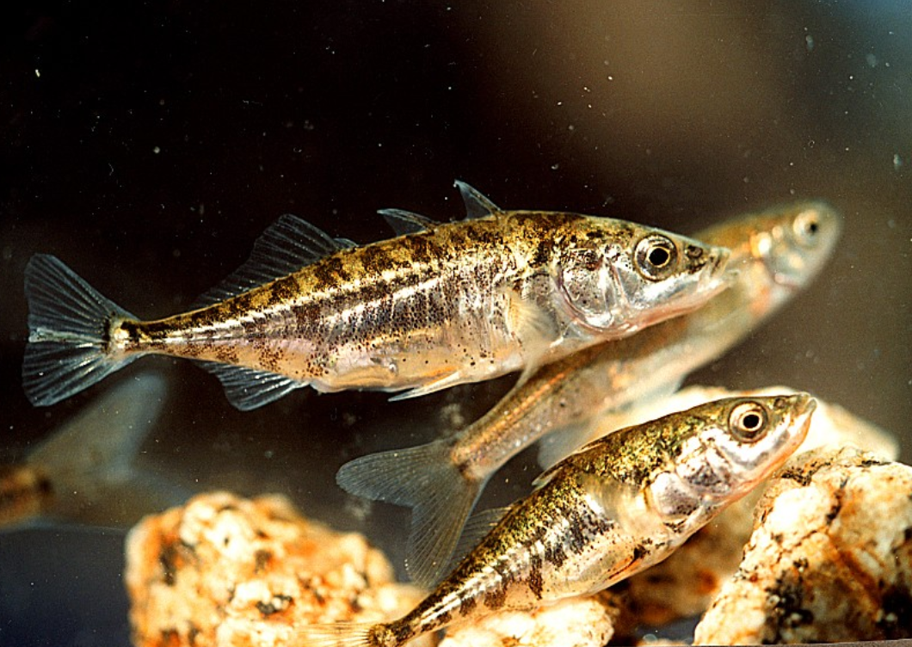
Example of fixed effects
Reciprocal relocation experiment to investigate how genotype and habitat interact to determine the fitness of stickleback fish (Rundle 2002).
 |  | Source habitat
 |  | Shallow | Deep
Test habitat | Shallow | 12 fish | 11 fish
 | Deep | 7 fish | 11 fish

Slide 17
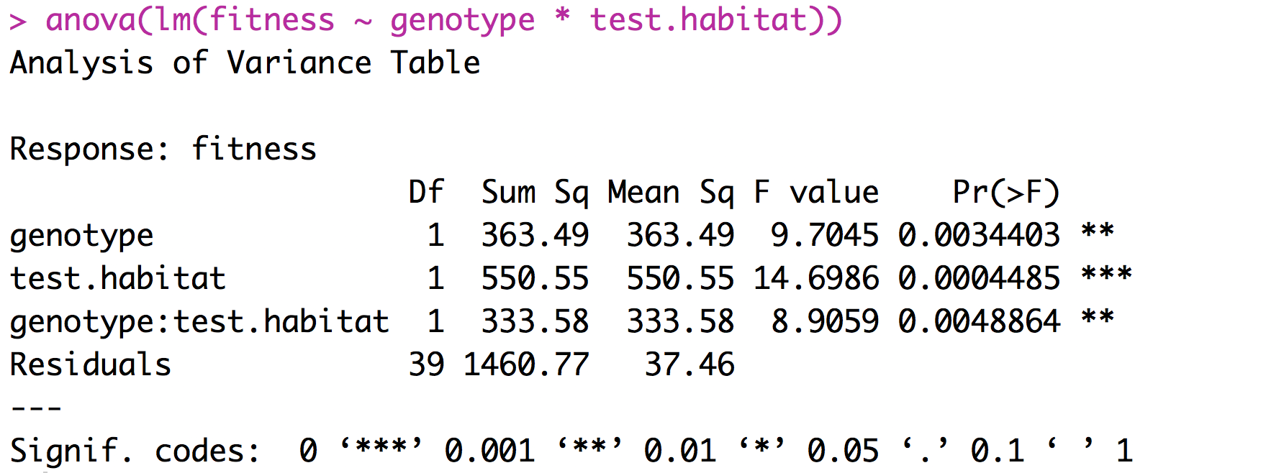
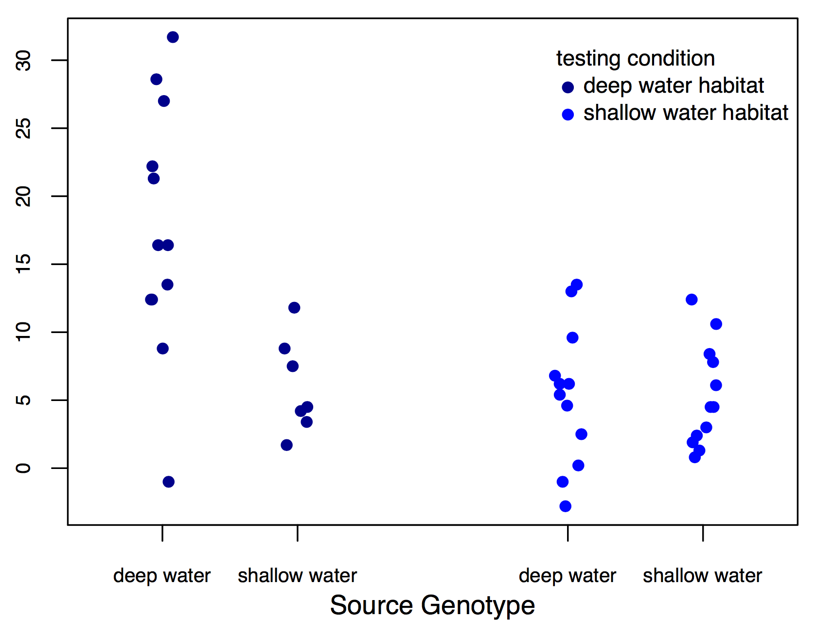
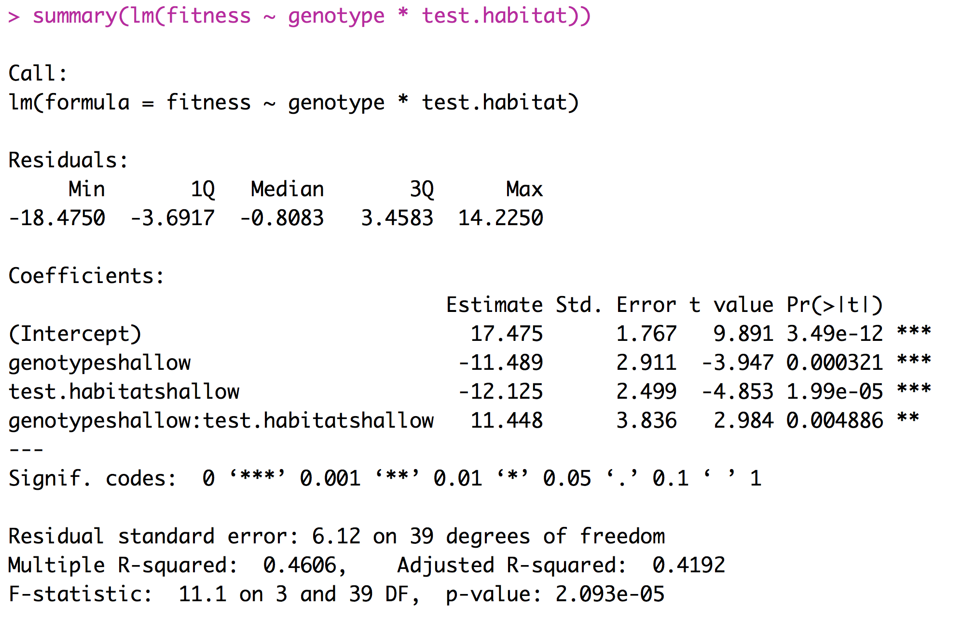
Example of fixed effects (two factor ANOVA)
fitness

Slide 18
Interpreting Coefficients

Slide 19
What is a random effect
These are randomly sampled categories of a variable that represent groups of individual measurements. Usually random effects are not repeatable.
Study sites
Environmental chambers
Families made up of siblings
Measurements within individuals
Conclusions that you reach are applicable only to the sample being studied.

Slide 20
What is a random effect
Sometimes random effects are a nuisance
Field sites
Environmental chambers
Field plots
Repeated measures
Occasionally random effects are of great interest
Families - Heritability
Individuals – Breeding value

Slide 21
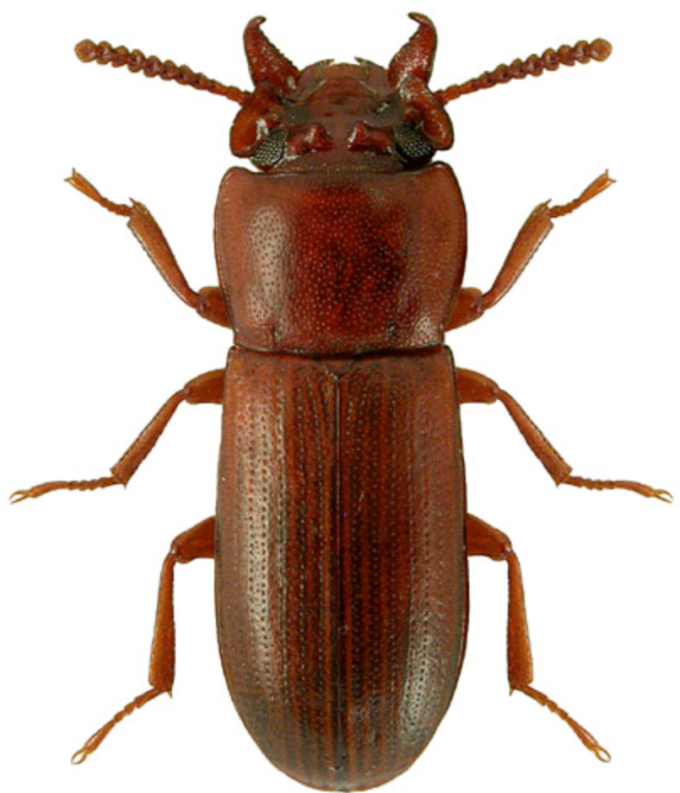
Example of random effects
Impact of selective regime on horn size. Measure both the left and right horn in 25 beetles from two different selective regimes.
Horn size | Beetle | Selective regime
256 276 321 321 423 401 381 409 | 1 1 2 2 3 3 4 4 | High High High High Low Low Low Low

Slide 22
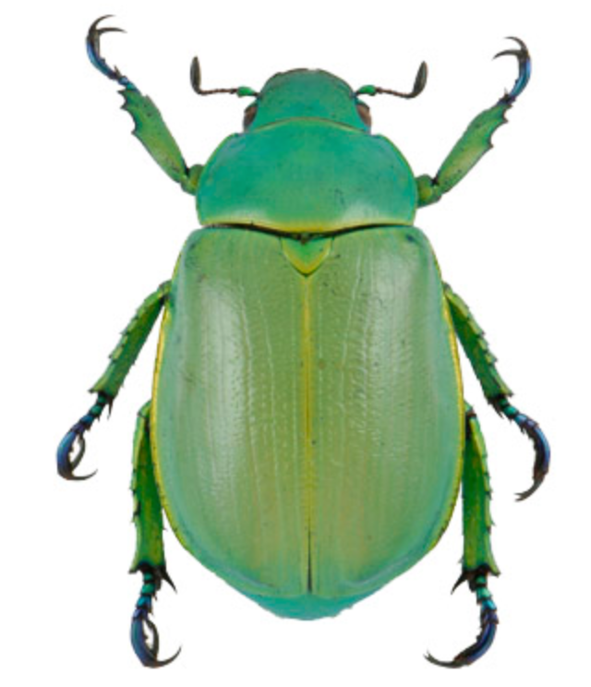
Example of random effects
Identifying the predictors for the presence or absence of Chrysina beetles.
Number collected | oak | juniper | site | date | trip
8 2 1 5 4 6 0 7 | 1 1 0 0 1 1 1 1 | 0 1 1 1 1 0 1 1 | 21 13 31 15 21 13 31 15 | 210 210 211 212 242 242 245 245 | A A A A B B B B

Slide 23
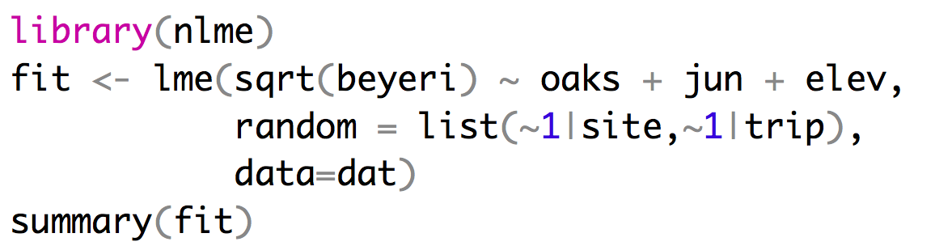
Implementing a mixed effects model
Fixed effects
Random effects
Repeated measures at sites can’t
be treated as independent
Random Intercept Model (~1 | site)
Only intercepts vary across groups.
Assumes that the effect of predictors is the same across all groups.
Random Slope Model (~ X | site)
Both intercepts and slopes for predictor X vary across groups.
Captures group-specific trends in the effect of X.

Slide 24
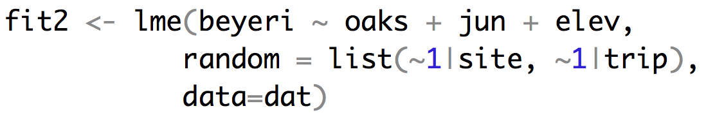
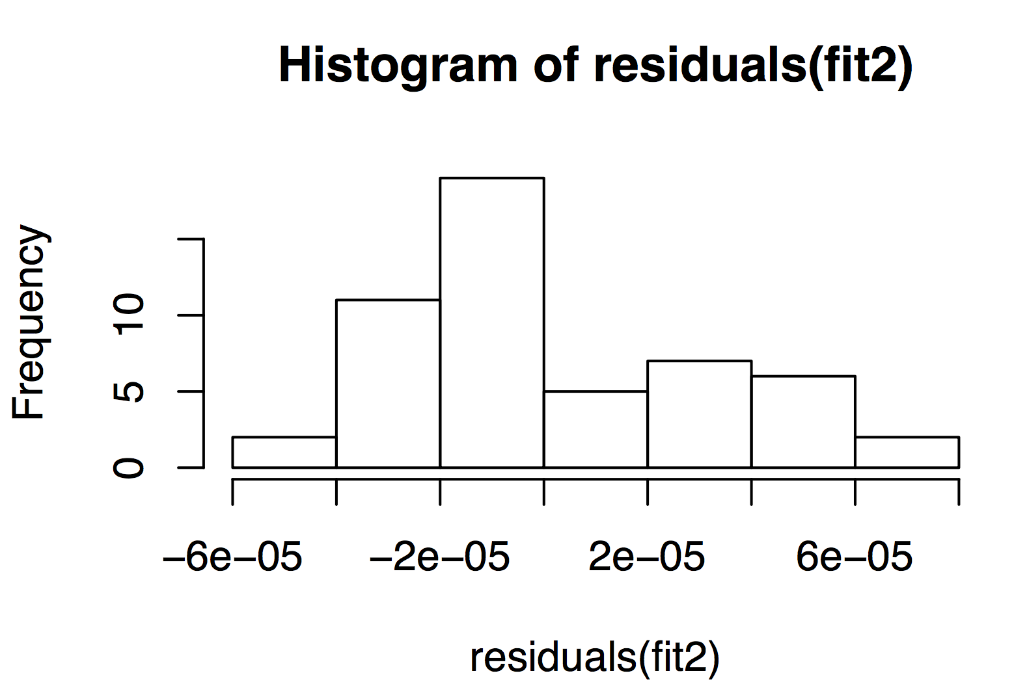
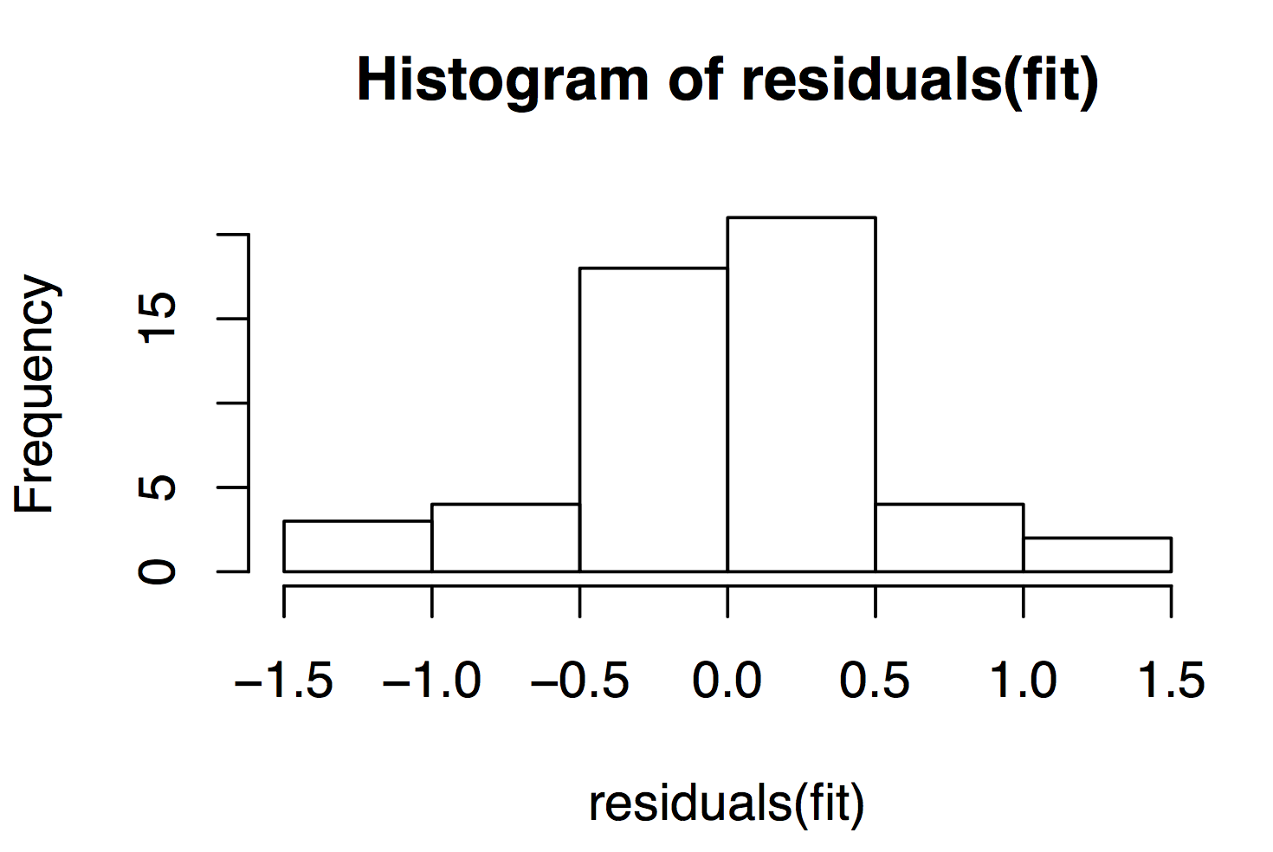
Implementing a mixed effects model

Slide 25
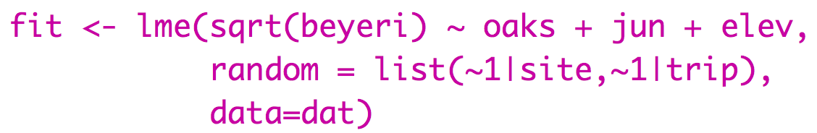
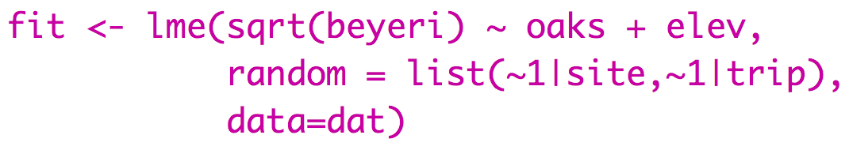
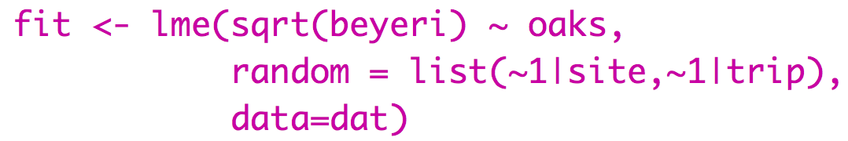
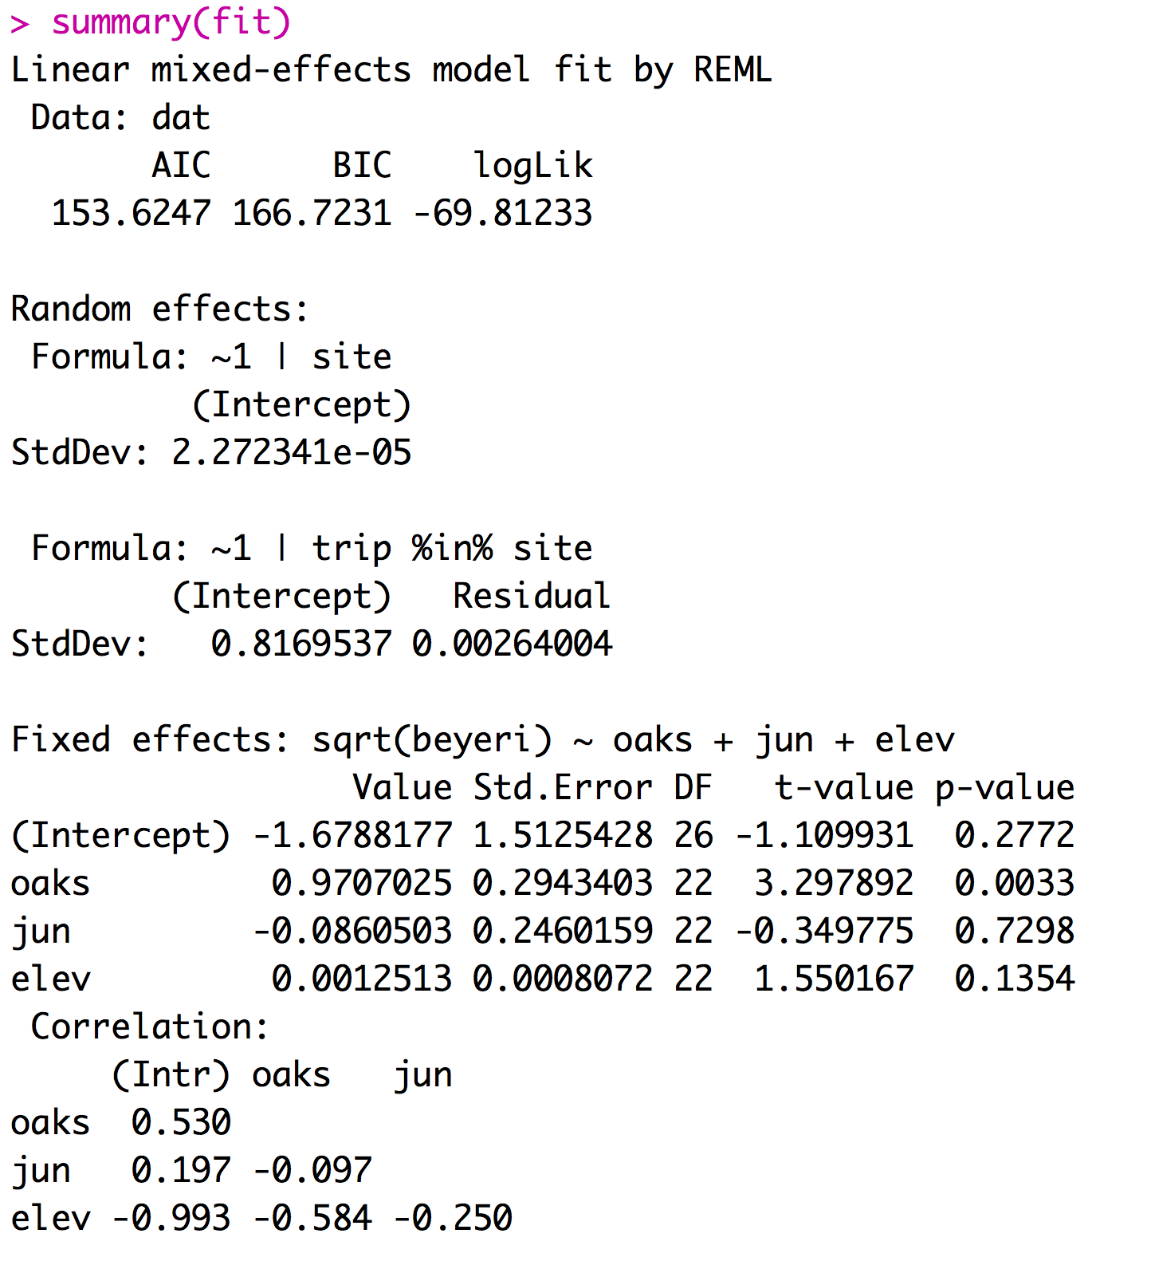
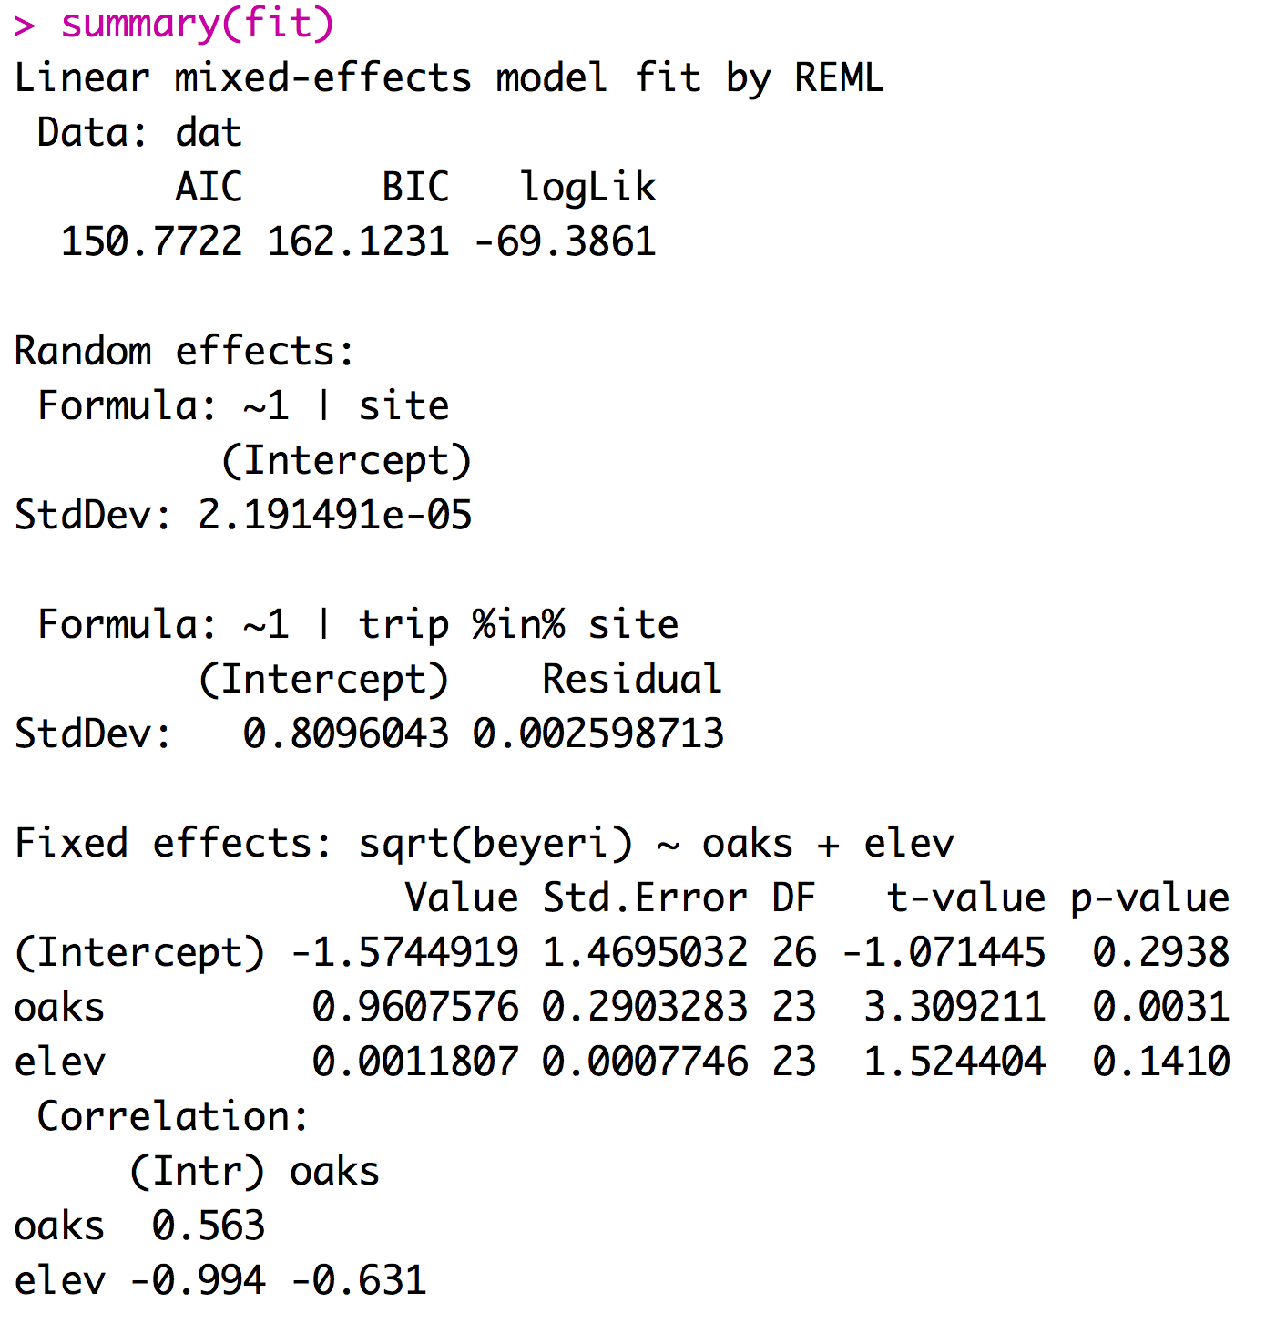
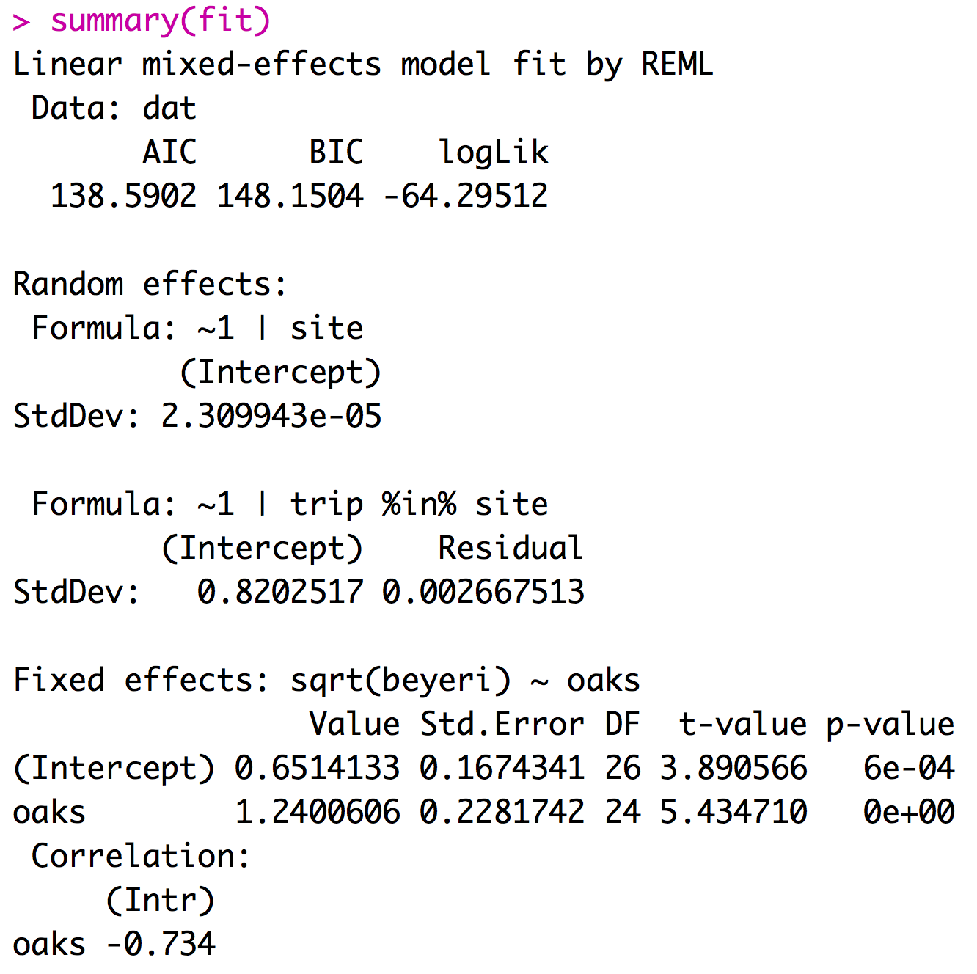
Implementing a mixed effects model
Mixed effect models can be fit using the LME function from the package nlme.
If you report your df with your F-statistic the reviewer will know if you did the right type of model

Slide 26
Considerations for models with random effects
Most software will assume that all factors are fixed unless you specify them as mixed.
Designating factors as random effects takes extra work.
The lm function treats all predictors as fixed effects.
Treating random effects as fixed effects is fundamentally wrong.

Slide 27
Links
MCMCMglmm: Fit mixed models with phylogenetic or pedigree information in a Bayesian framework.
Outlier Package: Apply outlier tests to identify possible outlier datapoints - I don’t recommend this.

Slide 28
Monte Carlo Methods
The name "Monte Carlo" comes from the Monte Carlo Casino in Monaco, famous for its games of chance and association with gambling and randomness. The term was coined in the 1940s by scientists working on the Manhattan Project during World War II.

Slide 29
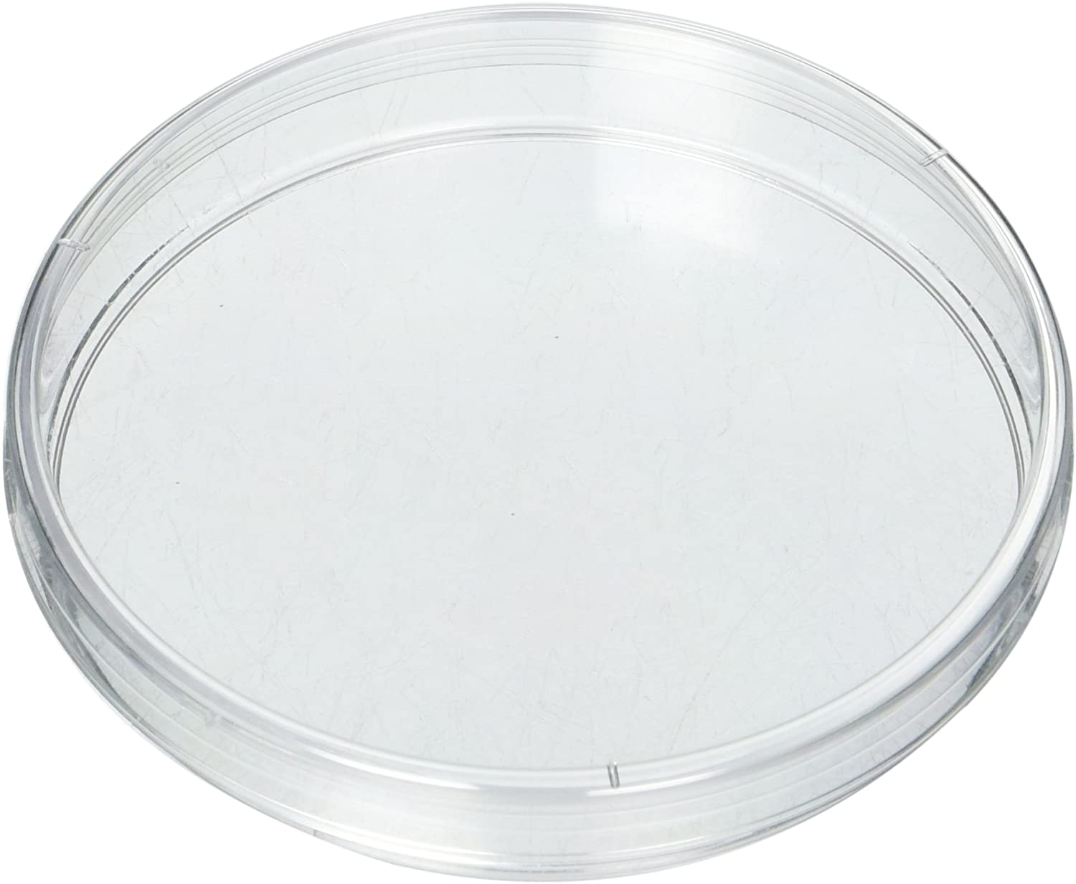
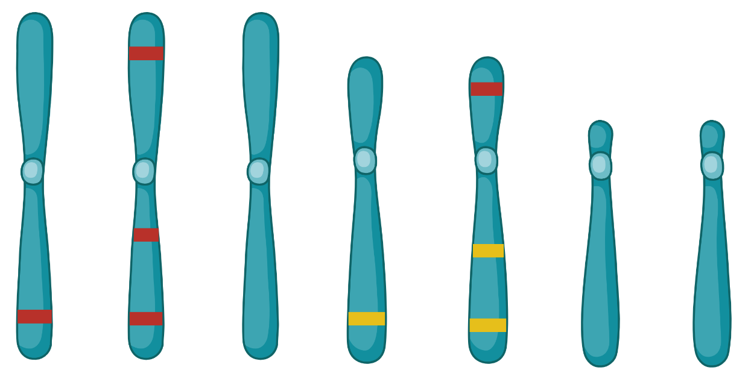
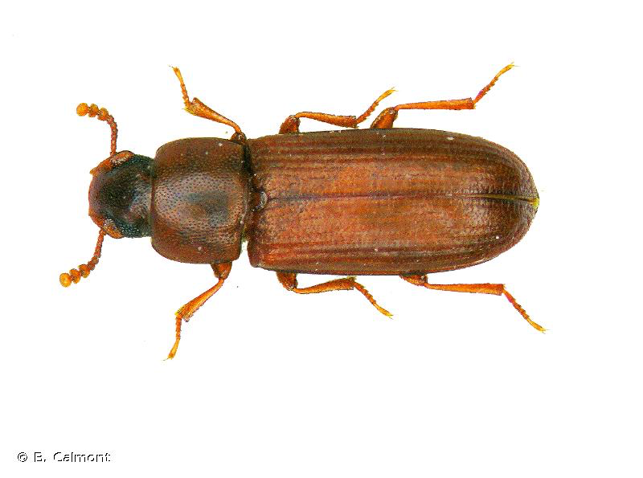
You will eventually be faced with questions where you can’t find a clear statistical test that will be appropriate to your data.
Are these beetles randomly distributed, aggregating or avoiding each other?
Does chromosome 2 have more “red” genes than I would expect by chance?

Slide 30
You will eventually be faced with questions where you can’t find a clear statistical test that will be appropriate to your data.
Monte Carlo methods are most similar to permutation methods that we have used previously. The distinction between the two is that with permutations we simply randomized data. In contrast, with Monte Carlo we will use a simulation process that represents the biology of a null hypothesis.

Slide 31
Monte Carlo methods offer an approach to answer difficult often complex questions.
Lets look at an example with retrogenes.

Slide 32
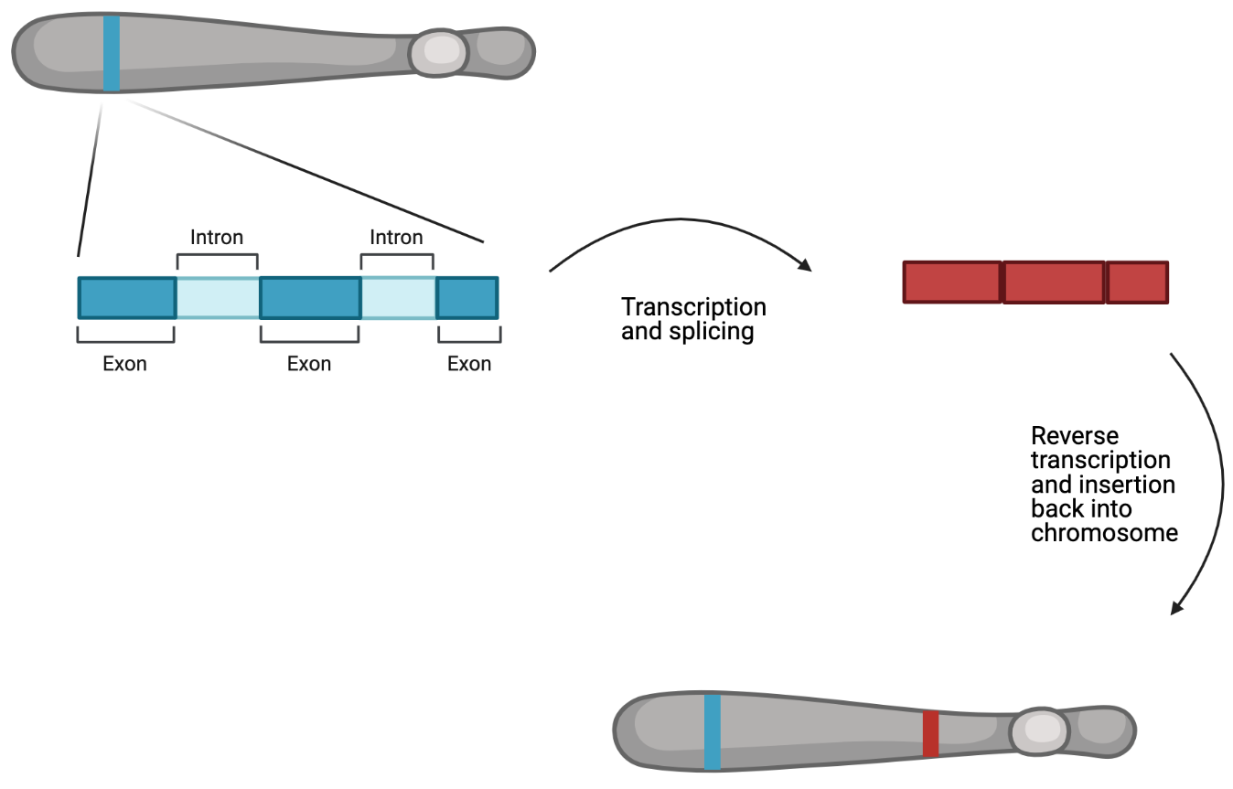
Lets look at an example with retrogenes.

Slide 33
Sexual antagonism hypothesis of retrogene distribution:
If some genes have variation that is beneficial to one sex but harmful to the other fitness could be increased in two ways.
make a duplicate of a gene and express one version in males and one in females
make a duplicate of a gene and move it from an autosome to an X or Y chromosome
Additionally in many species the sex chromosomes do not get expressed during meiosis if you have a gene that can benefit males during spermatogenesis moving this type of gene from a sex chromosome to an autosome will be beneficial.

Slide 34
From this sexual antagonism hypothesis we might expect to see more retrogenes on sex chromosomes and possibly more parental genes on sex chromosomes than we would expect by chance.

Slide 35
We identified retrogenes in a Tribolium beetle that has a recent fusion of chromosome 2 (lg2) to the sex chromosome. This means that the X in this species now include everything that is in lg2 as well as lgX.
 | lg1 | lg2 | lgX | lg4 | lg5 | lg6 | lg7 | lg8 | lg9 | lg10 | Total
GeneNumber | 3254 | 2941 | 3705 | 1507 | 1543 | 1287 | 994 | 684 | 325 | 212 | 16512
PhysicalSize | 45 | 41 | 38 | 30 | 20 | 15 | 14 | 11 | 12 | 9 | 235
Parents | 22 | 45 | 39 | 9 | 8 | 7 | 8 | 3 | 1 | 0 | 142
Daughters | 24 | 40 | 35 | 15 | 7 | 6 | 5 | 4 | 5 | 1 | 142

Slide 36
We identified retrogenes in a Tribolium beetle that has a recent fusion of chromosome 2 (lg2) to the sex chromosome. This means that the X in this species now include everything that is in lg2 as well as lgX.
 | lg1 | lg2 | lgX | lg4 | lg5 | lg6 | lg7 | lg8 | lg9 | lg10 | Total
GeneNumber | 3254 | 2941 | 3705 | 1507 | 1543 | 1287 | 994 | 684 | 325 | 212 | 16512
PhysicalSize | 45 | 41 | 38 | 30 | 20 | 15 | 14 | 11 | 12 | 9 | 235
Parents | 22 | 45 | 39 | 9 | 8 | 7 | 8 | 3 | 1 | 0 | 142
Daughters | 24 | 40 | 35 | 15 | 7 | 6 | 5 | 4 | 5 | 1 | 142
What is the probability that we would observe this many parents and daughters assuming that chromosome 2 is no different than any other chromosomes?

Slide 37
From this we might hypothesize that we should see more retrogenes on sex chromosomes and possibly more parental genes on sex chromosomes than we would expect by chance.
Size of the chromosome (determines probability of a daughter gene being on a chromosome)
Number of genes on each chromosome (determines the probability of a parent gene being on a a chromosomes)

Slide 38
First decide what we want to test
the number of parents on lg2
the number of daughters on lg2
Create an object to store a null distribution of these values
Simulate an expected number of parents and and an expected number of daughters on lg 2.
when simulating account for chromosome size and gene number
Repeat step 3 thousands of times.
Compare our observation to the null distribution to calculate a p-value for our observation.

